Slide 1

Decision Trees
A beginner-friendly introduction to one of Machine Learning's most intuitive algorithms — making predictions through a sequence of smart decisions.
Classification
Regression
Predict categories like Pass / Fail
Predict continuous values like house prices
Interpretable
Decisions you can read and explain

Slide 2

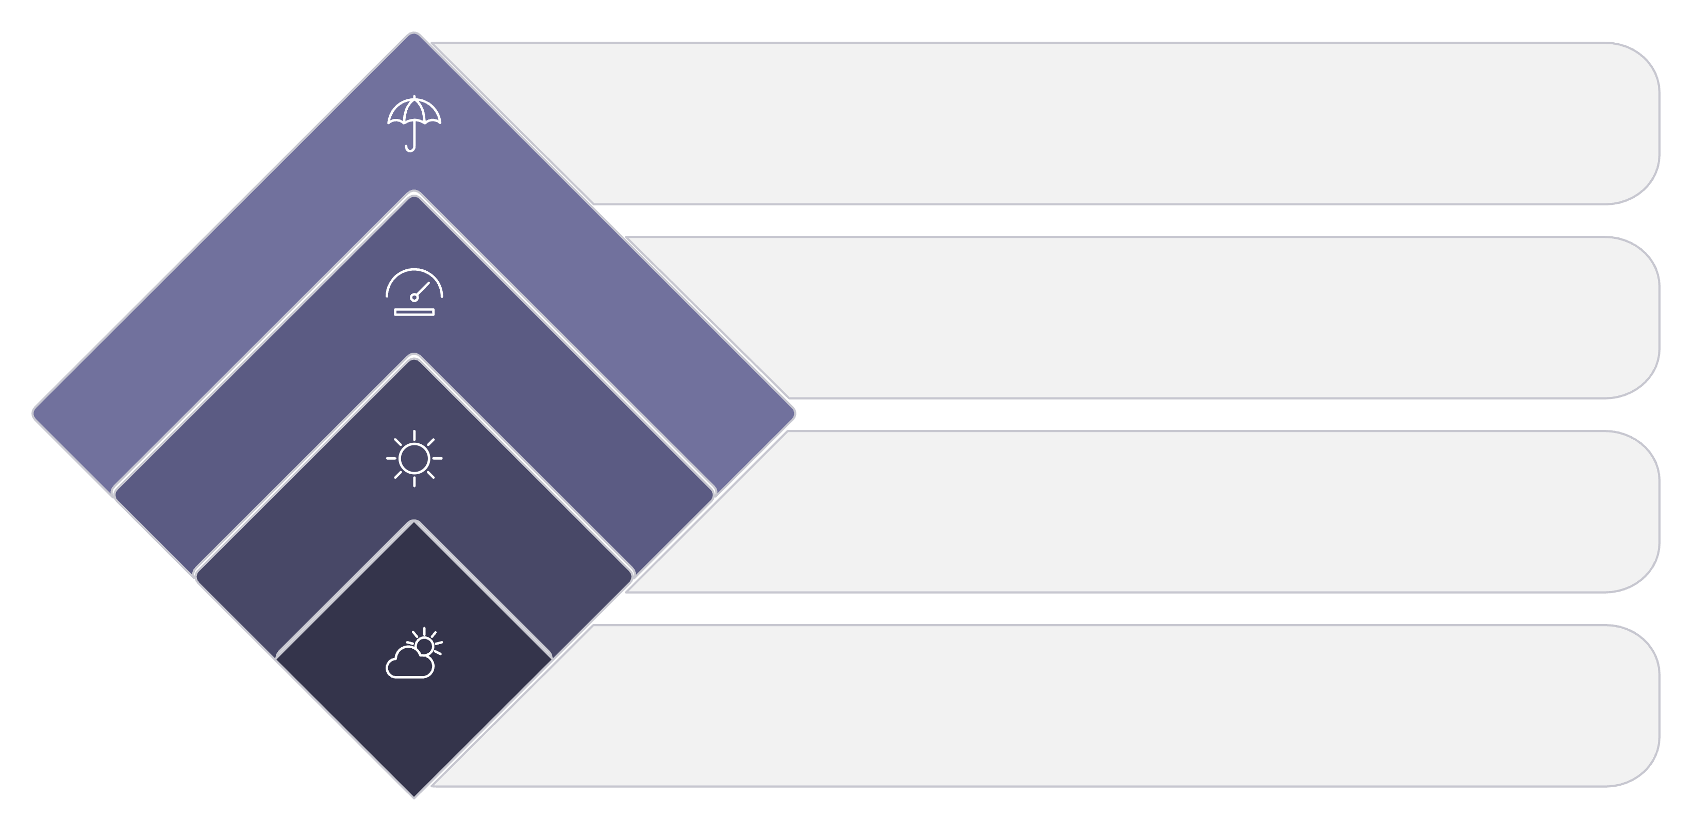
How Does a Decision Tree Work?
A Decision Tree is a flowchart-like structure where each internal node asks a question, each branch represents an answer, and each leaf delivers a prediction.
Root Node
1
The very first question asked — the most informative feature in the dataset.
Rainy
Don't play
Decision Node
Humidity?
2
An internal node that asks a follow-up question and branches further.
High or Normal
Sunny
Branch
Check humidity next
3
The path taken based on the answer to a question (Yes / No, High / Low).
Weather?
Root decision point
Leaf Node
4
The final node — delivers the prediction or class label.

Slide 3

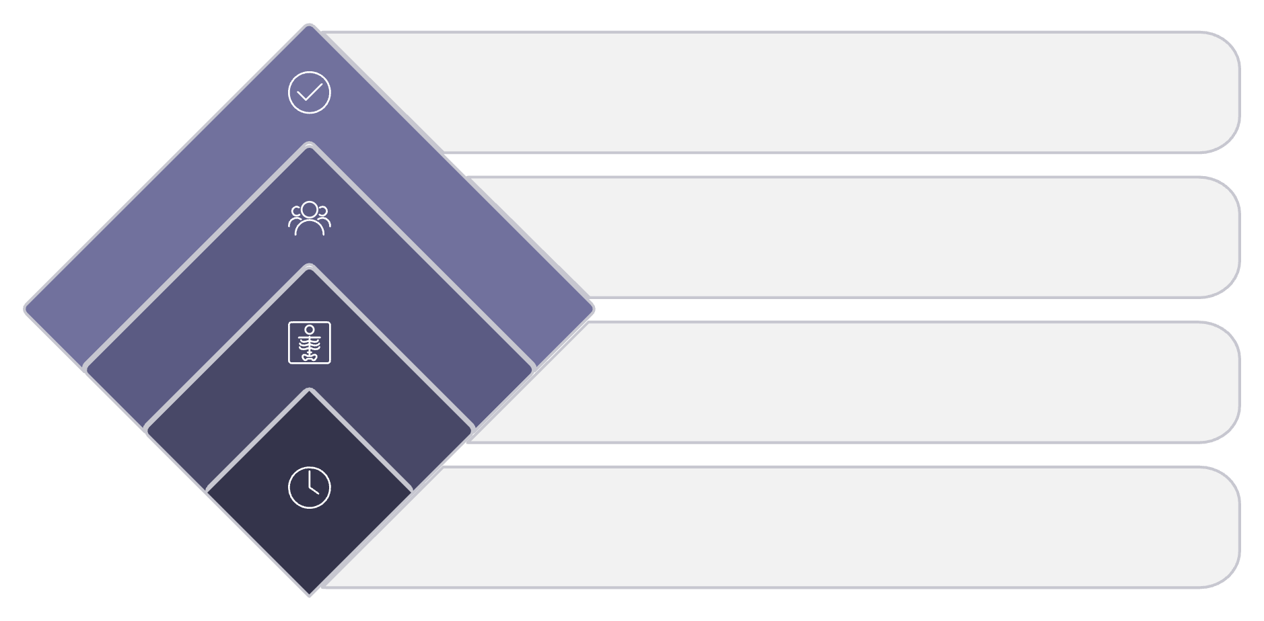
Classification Decision Tree
Predict whether a student will Pass or Fail based on three features: Hours Studied, Attendance, and Previous Score.
Step-by-Step Prediction
1
Start at the Root
Ask: Did the student study more than 5 hours?
Pass
Yes branch outcome
2
Follow the Branch
Attendance > 75%?
If No → predict Fail immediately.
Secondary decision
Fail
No branch outcome
3
Next Decision
Hours Studied > 5?
Root decision check
If Yes → ask: Is attendance above 75%?
4
Reach the Leaf
Yes → Pass. No → Fail. Prediction complete.

Slide 4
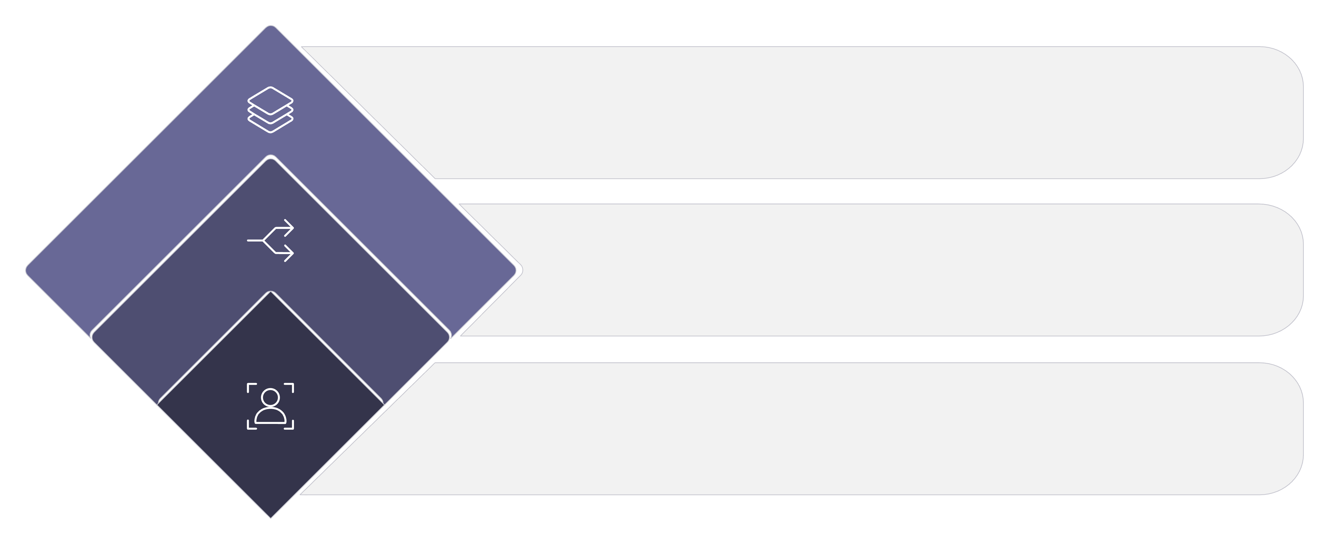



How Does the Tree Choose a Question?
The tree repeatedly splits the dataset into smaller groups. The goal is to create groups that are as pure as possible — where one class dominates.
Purer Groups
Each group is more homogeneous
Split
A question divides the data
Mixed Data
All classes jumbled together
Three mathematical criteria guide the tree in choosing the best split at every node:
Gini Impurity
Entropy
Information Gain
Measures how often a randomly chosen element would be incorrectly classified. Lower is better.
Measures disorder or uncertainty in a node. A pure node has entropy = 0.
The reduction in impurity achieved by a split. The tree always picks the highest gain.

Slide 5

Gini Impurity — Mathematical Example
The Formula
Interpreting Gini Impurity
Gini = 0 → Perfectly Pure
Where pᵢ is the proportion of observations belonging to class i, and Σ sums across all classes.
All observations belong to a single class. The node is completely homogeneous — ideal outcome.
Our Node Contains:
6 Pass students
4 Fail students
Gini = 0.48 → Mixed Node
Our example node is fairly mixed — 60% Pass, 40% Fail. The tree will try to split this further.
Higher Gini → More Mixed
The closer Gini is to 0.5 (binary case), the more impure and uncertain the node is.

Slide 6
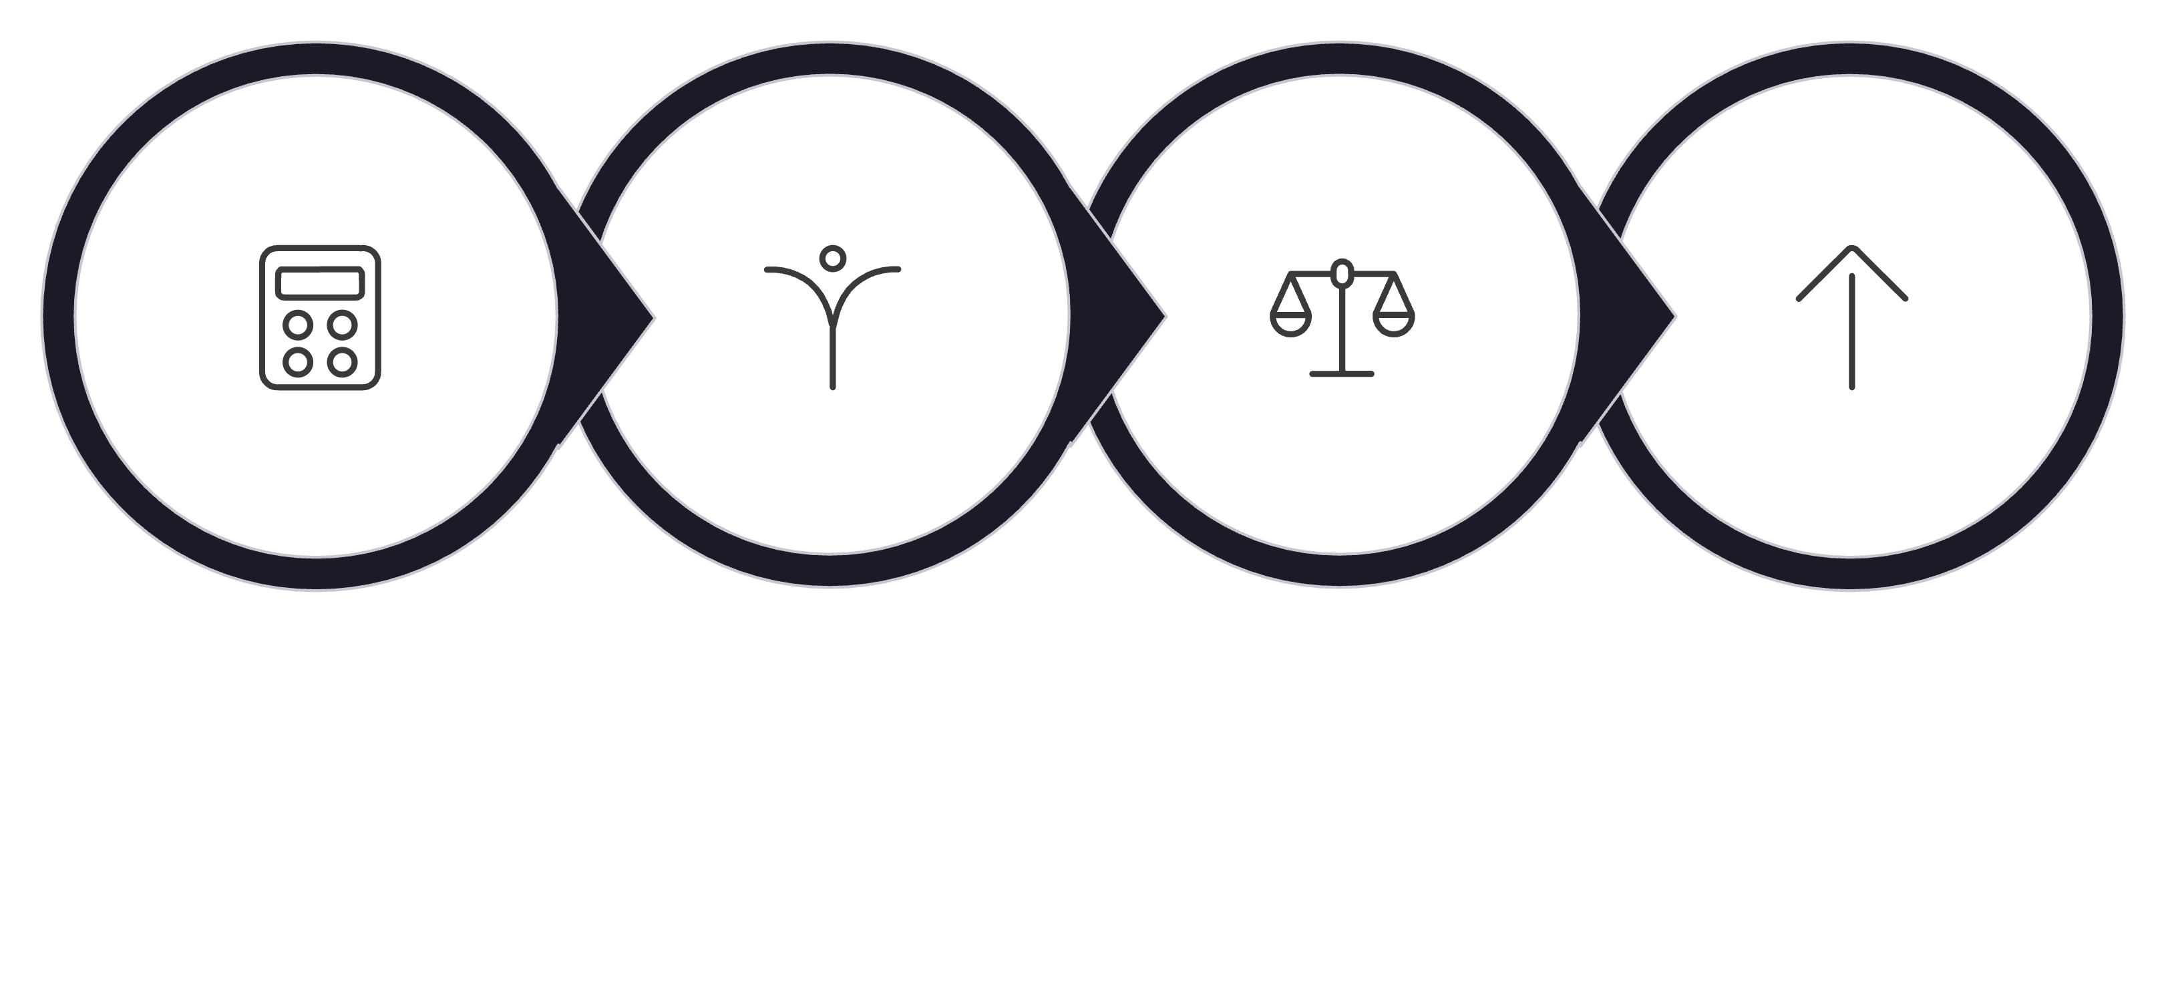

Information Gain
The tree evaluates every candidate split and selects the one that reduces impurity the most.
Comparing Two Splits
Split A
Information Gain = 0.20
Moderate reduction in impurity. Acceptable but not optimal.
Split B ✓
Information Gain = 0.35
Higher gain — creates purer child nodes. Split B is preferred.
Parent Impurity
Try Splits
Weighted Child
Pick Best Gain
Always choose the split with the highest Information Gain — it creates the purest child nodes and leads to better predictions.

Slide 7
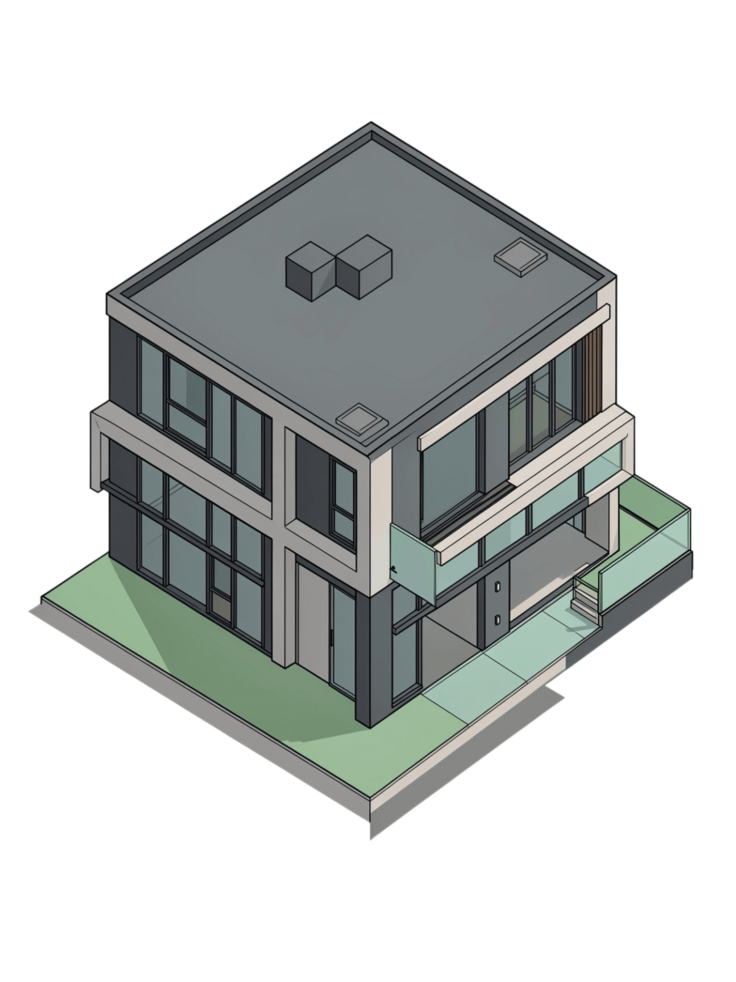

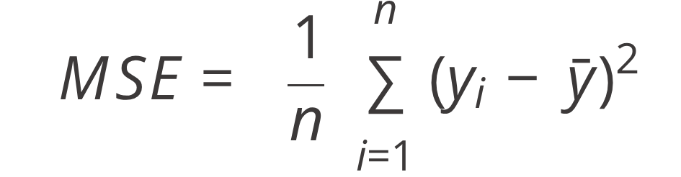
Decision Tree for Regression
Decision Trees are not only used for classification. For regression, the tree predicts a continuous numerical value — such as a house price — rather than a category.
How Regression Trees Predict
Each leaf node stores the average value of all training observations that fall into it. A new data point travels down the tree and receives that average as its prediction.
Yes → Avg Price
Splitting Criterion: MSE
₹90 lakh
Bedrooms > 3?
Secondary decision
No → Avg Price
Instead of Gini or Entropy, regression trees minimize Mean Squared Error (MSE) at each split — choosing the question that makes the resulting groups as uniform in value as possible.
₹50 lakh
House Size > 1000?
Root decision split
Features Used
House Size (sq.ft)
Number of Bedrooms
Location

Slide 8
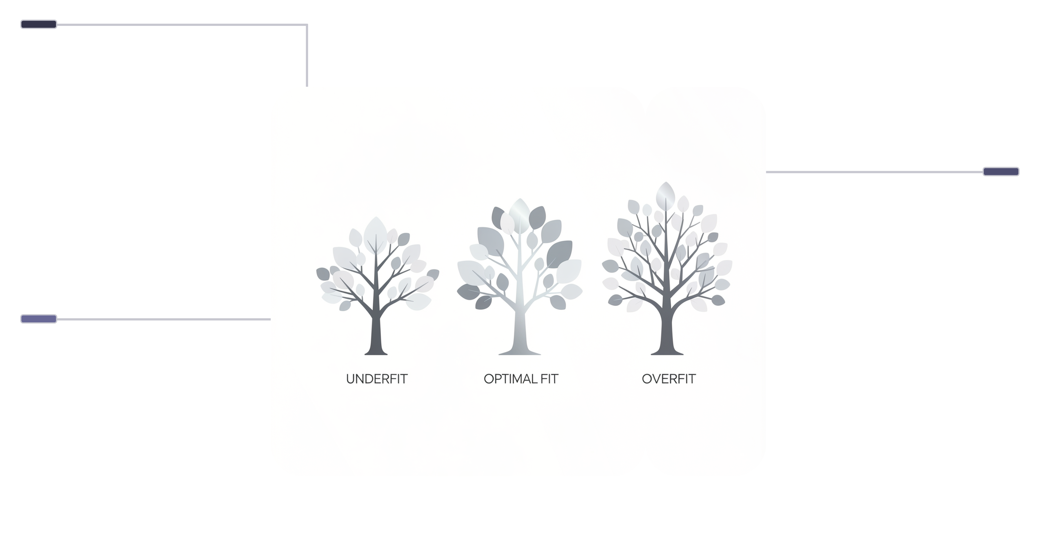

Overfitting and Tree Depth
One of the most important challenges with Decision Trees is overfitting — when the tree memorizes training data instead of learning general patterns.
Key Hyperparameters to Control Depth
max_depth
Too Shallow
Limits how many levels deep the tree can grow.
Underfits, misses patterns
min_samples_split
Just Right
Minimum samples required to split an internal node.
Good complexity, generalizes well
min_samples_leaf
Minimum samples required to be at a leaf node.
Too Deep
Overfits, learns noise
max_features
Number of features to consider when looking for the best split.
A tree with no depth limit will perfectly fit training data but perform poorly on unseen data. Always tune these hyperparameters.

Slide 9

Decision Tree Evaluation & Advantages/Disadvantages
Evaluating decision trees involves understanding various metrics for both classification and regression tasks, alongside considering their inherent strengths and weaknesses.
Evaluation Metrics
Advantages & Disadvantages
Different metrics are used depending on whether the decision tree is performing classification (predicting categories) or regression (predicting continuous values).
Decision trees offer significant benefits in interpretability and versatility, but also come with challenges, particularly regarding model complexity and generalization.
Classification Metrics
Regression Metrics
Advantages
Disadvantages
Accuracy
Precision
Recall
F1 Score
Confusion Matrix
Mean Absolute Error (MAE)
Mean Squared Error (MSE)
Root Mean Squared Error (RMSE)
R-squared (R²)
Easy to understand
Easy to visualize
Handles nonlinear relationships
Requires little preprocessing
Can work with numerical and categorical features
Can easily overfit
Sensitive to small changes in data
Deep trees can become difficult to interpret
Individual trees may have weaker generalization than ensemble methods

Slide 10


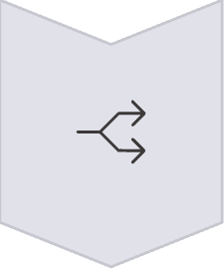
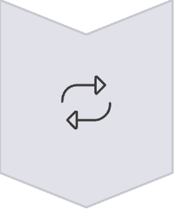
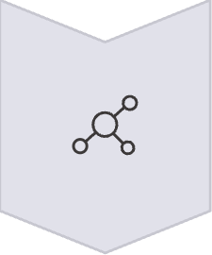

Summary & Real-World Applications
Here's a comprehensive overview of the Decision Tree workflow, key concepts, and practical applications.
Data
Choose Best Feature/Split
Split Dataset
Repeat Splitting
Reach Leaf Node
Make Prediction
Key Concepts
Real-World Applications
Root Node
Decision Node
Branch
Leaf Node
Gini Impurity
Entropy
Information Gain
Tree Depth
Overfitting
Loan approval
Fraud detection
Medical diagnosis
Customer churn
Spam detection
Student performance prediction
House price prediction
Credit risk assessment
Input Features → Questions → Branches → Leaf → Prediction

